Slide 1

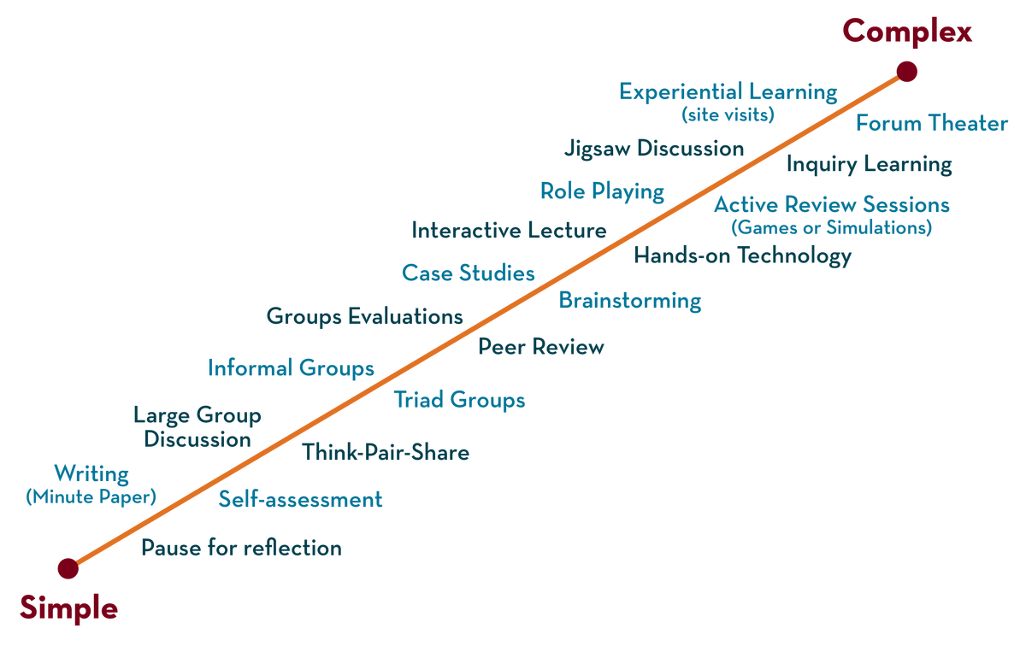
Department of CSE-Honors--
COURSE NAME – Software Engineering
COURSE CODE – 21CS2111RA
Topic:
Name of the topic – Software IEEE Definition
Session - 1

Slide 2



AIM OF THE SESSION
To familiarize students with the basic concept of nature of software
INSTRUCTIONAL OBJECTIVES
This Session is designed to:
Demonstrate Software Engineering Definition - IEEE
Describe A Layered Technology
List out the Software Process and process framework activity
Describe the Umbrella Activities , Software Engineering Practice, Software Myths
LEARNING OUTCOMES
At the end of this session, you should be able to:
Define Software Engineering Definition - IEEE
Describe Software Process and process framework activity
Summarize Umbrella Activities , Software Engineering Practice, Software Myths

Slide 3
SESSION INTRODUCTION
AGENDA
Software Engineering Definition - IEEE
A Layered Technology
Software Process
Process framework Activities
Umbrella Activities
Software Engineering Practice
Software Myths

Slide 4
Software Engineering
SESSION DESCRIPTION
Some realities:
a concerted effort should be made to understand the problem before a software solution is developed
design becomes a pivotal activity
software should exhibit high quality
software should be maintainable
The seminal definition:
[Software engineering is] the establishment and use of sound engineering principles in order to obtain economically software that is reliable and works efficiently on real machines.

Slide 5
SESSION DESCRIPTION (Cont..)
The IEEE definition:
Software Engineering:
The application of a
Systematic,
Disciplined,
Quantifiable approach
to the development, operation, and maintenance of
software;
that is, the application of engineering to software.

Slide 6
A Layered Technology
SESSION DESCRIPTION (Cont..)
tools
methods
process model
a “quality” focus
Software Engineering
Software engineering is fully a layered technology, to develop software we need to go from one layer to another. All the layers are connected and each layer demands the fulfillment of the previous layer. Fig: The diagram shows the layers of software development

Slide 7
SESSION DESCRIPTION
A Layered Technology
Quality: Organization is commitment to quality
Process: Manages the control of software projects
Ensures quality, establishes milestones, manages changes
Methods: Provide technical ways for building software i.e;
Communication, requirement analysis, design modeling, program construction , testing and support
Tools: Provide automated or semi automated support for the process & methods

Slide 8
SESSION DESCRIPTION (Cont..)
The Software Process
A Process is collection of activities, actions, and tasks that are performed when some work product is to be created
Activity-Strives to achieve a broad objective
(eg: communication with stakeholders)
Actions- encompasses a set of tasks that produce a major work
product (eg: architectural design)
Task-focusses on small, but well-defined objective that
produces a tangible outcome (eg: conduct a unit test)

Slide 9
Process framework Activities
SESSION DESCRIPTION (Cont..)
Communication
Planning
Modeling
Analysis of requirements
Design
Construction
Code generation
Testing
Deployment

Slide 10
Process framework Activities(cont.)
SESSION DESCRIPTION
Communication: communicate with customer to understand objectives and gather requirements
Planning: creates a “map” that defines the work by describing tasks, risks and resources, work products and work schedule.
Modeling: Create a “sketch”, what it looks like architecturally, how the essential parts fit together and other characteristics.
Construction: code generation and the testing.
Deployment: Delivered to the customer who evaluates the products & provides feedback based on the evaluation.

Slide 11
SESSION DESCRIPTION (Cont..)
Process framework Activities(cont.)
These five framework activities can be used to all software development, regardless of the application domain, size of the project, complexity of the efforts etc.
though the details will be different in each case.
For many software projects, these framework activities are applied iteratively as a project progresses. Each iteration produces a software increment that provides a subset of overall software features and functionality.

Slide 12
Umbrella Activities
SESSION DESCRIPTION (Cont..)
What are umbrella activities in software engineering?
Software engineering is a collection of interconnected phases. These steps are expressed or available in different ways in different software process models. Umbrella activities are a series of steps or procedures followed by a software development team to maintain the progress, quality, changes, and risks of complete development task
Need for umbrella activities
In general, umbrella activities are applied throughout a software project and help a software team manage and control progress, quality, change, and risk. Since the software engineering process is not a rigid regimen that must be followed precisely by a software team, the process has a lot of room for adaptation

Slide 13
Umbrella Activities
SESSION DESCRIPTION
Complete the five process framework activities and help team manage and control progress, quality, change, and risk.
Software project tracking & control: assess progress against the plan and take actions to maintain the schedule.
Risk management: assesses risks that may affect the outcome and quality.
Software quality assurance: defines and conduct activities to ensure quality.
Technical reviews: assesses work products to uncover and remove errors before going to the next activity.
Measurement: define and collects process, project, and product measures to ensure stakeholder’s needs are met.
Software configuration management: manage the effects of change throughout the software process.
Reusability management: defines criteria for work product reuse and establishes mechanism to achieve reusable components.
Work product preparation and production: create work products such as models, documents, logs, forms and lists.

Slide 14
The Essence of Practice
Software Engineering Practice
SESSION DESCRIPTION (Cont..)
How does the practice of software engineering fit in the process activities mentioned above? Namely,
communication,
planning,
modeling,
construction
deployment.
The essence of problem solving is outlined in 4 points:
1. Understand the problem (communication and analysis).
2. Plan a solution (modeling and software design).
3. Carry out the plan (code generation).
4. Examine the result for accuracy (testing and quality assurance).

Slide 15
Understand the Problem
SESSION DESCRIPTION (Cont..)
Who has a stake in the solution to the problem? That is, who are the stakeholders?
What are the unknowns? What data, functions, and features are required to properly solve the problem?
Can the problem be compartmentalized? Is it possible to represent smaller problems that may be easier to understand?
Can the problem be represented graphically? Can an analysis model be created?

Slide 16
Plan the Solution
SESSION DESCRIPTION
Have you seen similar problems before? Are there patterns that are recognizable in a potential solution? Is there existing software that implements the data, functions, and features that are required?
Has a similar problem been solved? If so, are elements of the solution reusable?
Can subproblems be defined? If so, are solutions readily apparent for the subproblems?
Can you represent a solution in a manner that leads to effective implementation? Can a design model be created?

Slide 17
Carry Out the Plan
SESSION DESCRIPTION (Cont..)
Does the solution conform to the plan? Is source code traceable to the design model?
Is each component part of the solution provably correct? Has the design and code been reviewed, or better, have correctness proofs been applied to algorithm?

Slide 18
Examine the Result
SESSION DESCRIPTION (Cont..)
Is it possible to test each component part of the solution? Has a reasonable testing strategy been implemented?
Does the solution produce results that conform to the data, functions, and features that are required? Has the software been validated against all stakeholder requirements?

Slide 19
Software Myths
SESSION DESCRIPTION
Affect managers, customers (and other non-technical stakeholders) and practitioners
Are believable because they often have elements of truth,
but …
Invariably lead to bad decisions,
therefore …
Insist on reality as you navigate your way through software engineering

Slide 20
1.Management Myths
SESSION DESCRIPTION (Cont..)
“We already have a book of standards and procedures for building software. It does provide my people with everything they need to know …”
“If my project is behind the schedule, I always can add more programmers to it and catch up …” (a.k.a. “The Mongolian Horde concept”)
“If I decide to outsource the software project to a third party, I can just relax: Let them build it, and I will just pocket my profits …”

Slide 21
2. Customer Myths
SESSION DESCRIPTION (Cont..)
“A general statement of objectives is sufficient to begin writing programs - we can fill in the details later …”
“Project requirements continually change but this change can easily be accommodated because software is flexible …”

Slide 22
3. Practitioner’s Myths
SESSION DESCRIPTION
“Let’s start coding ASAP, because once we write the program and get it to work, our job is done …”
“Until I get the program running, I have no way of assessing its quality …”
“The only deliverable work product for a successful project is the working program …”
“Software engineering is baloney(nonsense.). It makes us create tons of paperwork, only to slow us down …”
End of Session - 2

Slide 23
SELF-ASSESSMENT QUESTIONS
…
…
…
…
…
1. Define Software Engineering.
2. What is the need of Umbrella Activities.
3. What are different Layers of Software Engineering.
4. What are Process framework Activities.
5. What are different activities comes under Modeling face.
6. Need of Technical reviews in software development.
7. Need of Reusability management in software development process.
8. Need of Software quality assurance in software development process.
9. Define Myth ?
10. How many types of Myths available.
11. What are myths comes under Management Myths.
12. What are myths comes under Customer Myths. 13. What are myths comes under Practitioner’s Myths.

Slide 24
REFERENCES FOR FURTHER LEARNING OF THE SESSION
Reference Books:
2. TEXT BOOKS:
Roger S.Pressman, “Software Engineering – A Practitioner’s Approach” 7th Edition, Mc Graw Hill,(2014).
Ian Sommerville, “Software Engineering”, Tenth Edition, Pearson Education, (2015).
Reference Book
Agile and Iterative Development: A Manager's Guide, Craig Larman, Addison-Wesley
WEB REFERNCES/MOOCS:
https://www.digite.com/kanban/what-is-kanban/
http://www.scaledagileframework.com
https://www.guru99.com/test-driven-development.html
https://junit.org/junit5/
3.

Slide 25
THANK YOU
Team – Course Name

